Slide 1



SMART INDIA HACKATHON 2024
PROBLEM ID: 1707
PROBLEM STATEMENT TITLE
Development of a Geolocation-Based Attendance Tracking Mobile Application.
PS CATEGORY : software
TEAM NAME : SHIELD

Slide 2
DEVELOPMENT OF A GEOLOCATION-BASED ATTENDANCE TRACKING MOBILE APPLICATION
SHIELD
IDEA/ SOLUTION
GEOLOCATION-BASED CHECK-IN AND CHECK-OUT:
Automatic Tracking: The app automatically records check-in when an employee enters a defined geofence (e.g., 200-meter radius) around the office and check-out when they leave.
Manual Location Check-In/Out for Offsite Work:
Employees can manually check in and out when working offsite.
The app will suggest nearby locations based on real-time geolocation data to simplify manual entry.
ACCURATE TIME AND ATTENDANCE CALCULATION:
Calculate total working hours by aggregating check-in and check-out data.
DATA ACCURACY AND INTEGRITY:
Use secure storage and real-time synchronization to maintain accurate, tamper-proof records.
Ensure reliable data handling with encryption to prevent data loss.
ADMIN AND USER INTERFACES:
Admin Interface: Provides a dashboard for tracking live employee locations, check-in and check-out times, attendance status (e.g., present, absent), and other relevant employee information.
User Interface: Allows employees to manage their attendance, view their check-in/check-out history, and fill in basic information.
MACHINE LEARNING FOR ABSENTEEISM PREDICTION:
Use machine learning models to predict employee absenteeism trends, helping in workforce management and planning.

Slide 3
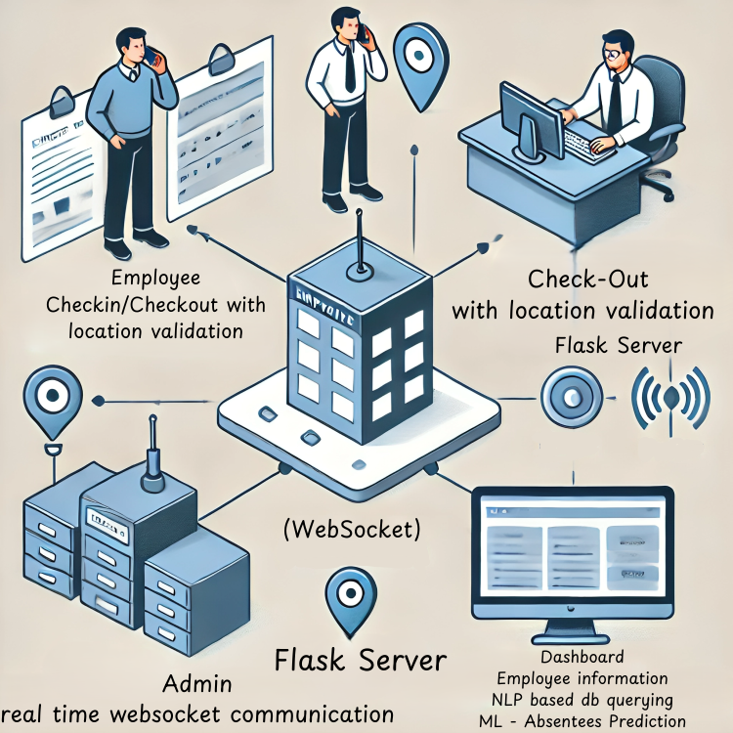
DEVELOPMENT OF A GEOLOCATION-BASED ATTENDANCE TRACKING MOBILE APPLICATION
SHIELD
WORKFLOW ARCHITECTURE

Slide 4
DEVELOPMENT OF A GEOLOCATION-BASED ATTENDANCE TRACKING MOBILE APPLICATION
SHIELD
PROBLEM RESOLUTION
MANUAL ATTENDANCE ERRORS:
Traditional attendance methods (e.g., biometric systems, manual registers) are prone to errors, manipulation, and administrative overhead. This app eliminates these issues by automating attendance tracking using geolocation.
OFFSITE WORK ATTENDANCE:
Employees working outside the office struggle with recording accurate attendance. The manual check-in and check-out feature with location suggestions addresses this gap.
COMPLEX MULTI-STORY WORKPLACES:
In multi-story buildings, it’s difficult to pinpoint an employee's exact location. By incorporating vertical positioning, the app provides precise data, enhancing security and operational oversight.

Slide 5
DEVELOPMENT OF A GEOLOCATION-BASED ATTENDANCE TRACKING MOBILE APPLICATION
SHIELD
UNIQUE VALUE PROPOSITIONS (UVP)
AUTOMATION AND PRECISION:
Automates the attendance process using geofencing, reducing manual errors and enhancing accuracy.
VERSATILITY:
Supports both in-office and offsite work scenarios, making it suitable for modern, flexible workplaces.
ENHANCED SECURITY:
Tracks the vertical position of employees in multi-story buildings, improving security and internal communication.
PREDICTIVE ANALYTICS:
Provides data-driven insights into employee attendance patterns and potential absenteeism, enabling proactive management.
REAL-TIME MONITORING:
Admins can monitor live locations and have access to detailed, real-time attendance data for better decision-making.

Slide 6
DEVELOPMENT OF A GEOLOCATION-BASED ATTENDANCE TRACKING MOBILE APPLICATION
SHIELD
TECH STACK
BACKEND :
Python flask
Nodejs
FRONTEND :
React (Web App)
React native (Android Application)
DATABASE :
Google firebase
Retrieval Augmented Generation (RAG)
ENCRYPTION AND SECURITY :
Google firebase
AI/ML MODEL :
Gemini 1.5 flash
Random forest
XG Boost
Deep learning
Time Series Prediction
CLOUD SERVICES :
Google firebase ,
PRODUCT STATUS : 65%

Slide 7
IMPACT AND BENEFITS
DEVELOPMENT OF A GEOLOCATION-BASED ATTENDANCE TRACKING MOBILE APPLICATION
SHIELD
OPERATIONAL EFFICIENCY:
Reduces the administrative burden of manual attendance management.
COST SAVINGS:
Minimizes the need for expensive hardware-based attendance systems (e.g., biometric systems).
EMPLOYEE SATISFACTION:
Provides a seamless user experience and flexibility, promoting employee satisfaction and productivity.
SCALABILITY:
Suitable for businesses of all sizes, from small startups to large enterprises.
DATA-DRIVEN DECISION MAKING:
Enables HR and management teams to make informed decisions based on reliable attendance data.

Slide 8
GEOLOCATION-BASED ATTENDANCE TRACKING MOBILE APPLICATION
DEVELOPMENT OF A GEOLOCATION-BASED ATTENDANCE TRACKING MOBILE APPLICATION
SHIELD
RESEARCH AND REFERENCES
https://firebase.google.com/docs
https://archive.ics.uci.edu/dataset/102/thyroid+disease
https://bmcbioinformatics.biomedcentral.com/articles/10.1186/s12859-022-04602-4

